Slide 1

Voting Healthy
A case study on voter participation and health metrics
By Russell Poon

Slide 2
The Study
Context
Question
Purpose
It is often thought that voter participation has little impact in their personal life, but how true is this statement
Does voting participation have an effect on health metrics in counties?
The primary purpose of this project is to determine a correlative relationship between voter participation and health metrics to determine if voting does have a significant impact on individuals

Slide 3
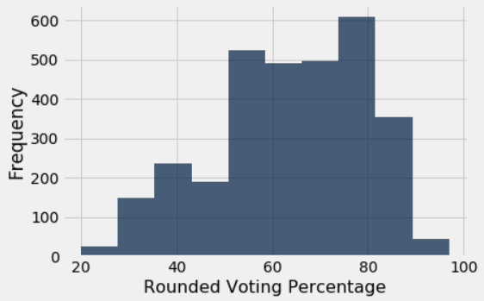
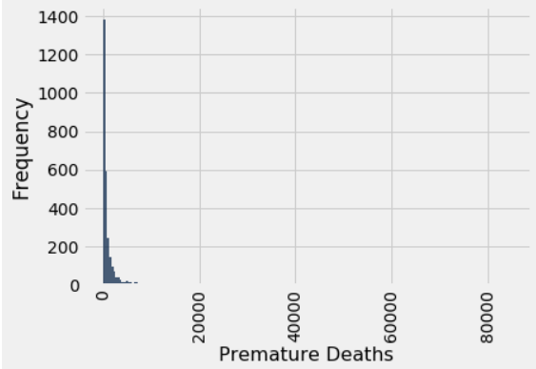
Basic Metrics and Information
Party Affiliation
Voting Participation
Premature Deaths
DEMOCRAT
546
REPUBLICAN
2569
There might be some possible bias due to the fact that a majority of counties are Republican
Median: 65.13% Q1: 52.02%
Mean: 63.35% Q3: 74.39%
Skewed to the left
Median: 476 Q1: 225
Mean: 1352.47 Q3: 1134
Skewed to the right

Slide 4
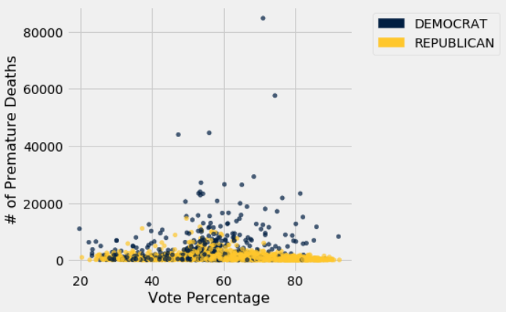
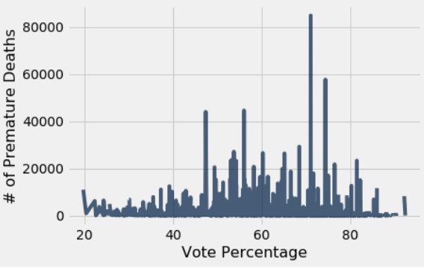
Correlation Coefficient: -0.0771
0 outliers in Voting Participation Percentage
323 outliers in Premature Deaths
This shows a very weak negative correlation meaning that there could be some correlation between voting participation and premature deaths but there could be other factors that influence it
Minor note, out of the original 3105 pieces of data only 2828 were used to calculate the coefficient due to the fact there were null values

Slide 5
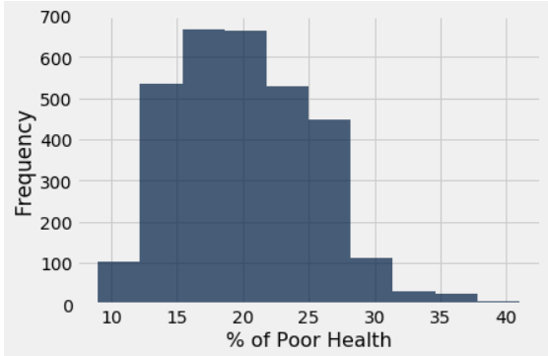
% of Poor Health
Metrics
% of Poor Health
Q1: 16
Q3: 24
Outliers: 24
Median: 20.12%
Mean: 20%
Skewed to the right

Slide 6
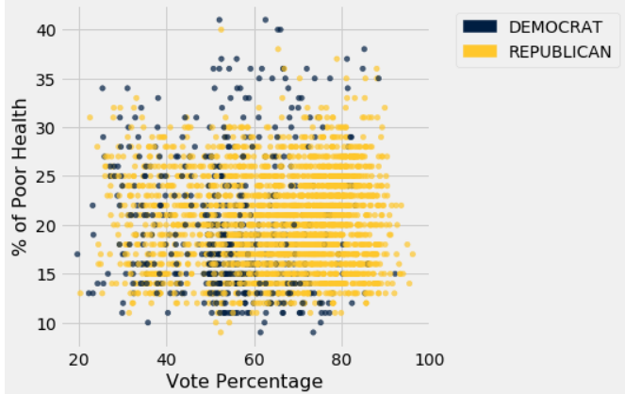
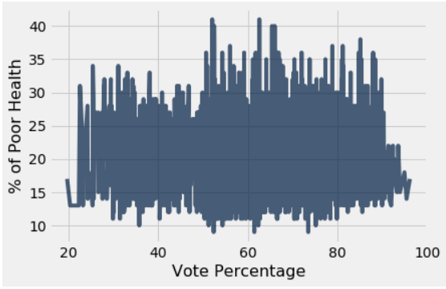
Correlation Coefficient: 0.0427
This shows a very weak positive correlation meaning that there could be some correlation between voting participation and poor health but there could be other factors that influence it

Slide 7
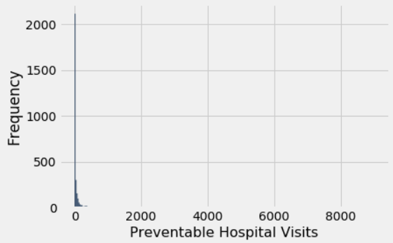
Preventable Hospitalizations
Metrics
Preventable Hospitalizations
Q1: 4
Q3: 42
Outliers: 419
Median: 12
Mean: 78.52
Extreme skew to the left

Slide 8
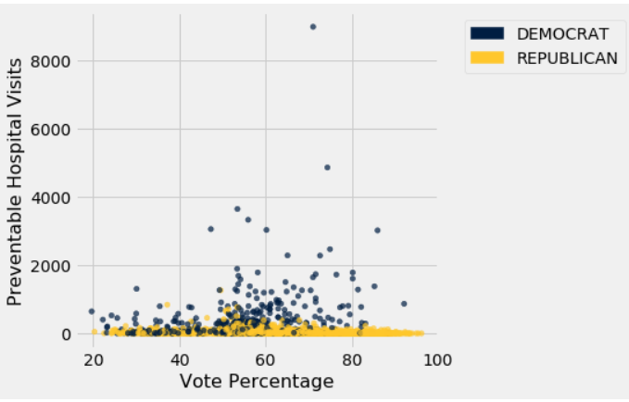
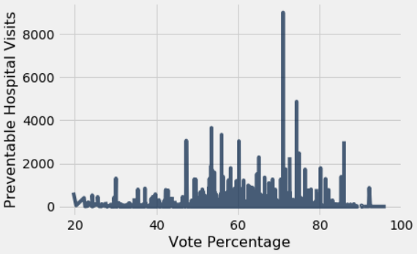
Correlation Coefficient: -0.0556
This shows a very weak negative correlation meaning that there could be some correlation between voting participation and preventable hospital visits but there could be other factors that influence it

Slide 9
Conclusion
Despite showing some correlation between voter participation and certain health metrics, the data is simply way too varied to truly determine correlation due to low correlation coefficients. This is most likely due to other variables involved that could influence such metrics
There is an effect, but barely

